Slide 1
Real-Time Crowd Detection at the Gym
April 30
By : Team008
Maria Sequeira
Yu Chin Chen
Rasika Teli
Balbir Singh
Harsh Kevadiya

Slide 2
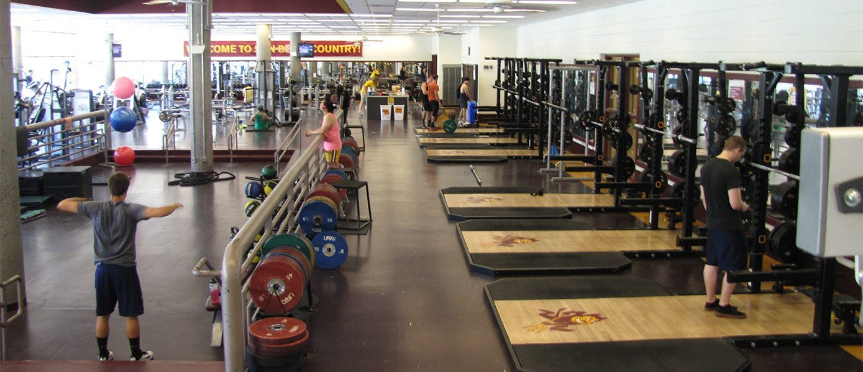
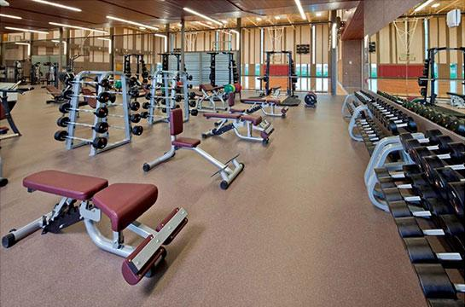
Introduction
Problem: Overcrowding at SDFC gym causes frustration and wasted time for students.
Importance: Students deserve fair and efficient access to gym facilities they are paying for.
Current Situation: No way for students to check gym crowd levels before arriving.
Goal: Build a crowd detection and visualization system using AI.
Approach: Use OpenCV and heatmaps to show live crowd density to students.
Integrate the visualization into a mobile app, allowing students to conveniently check real-time crowd levels from their phones.
Read More

Slide 3
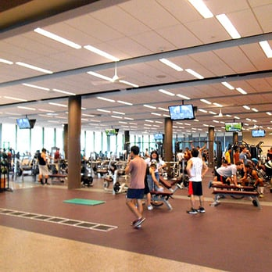
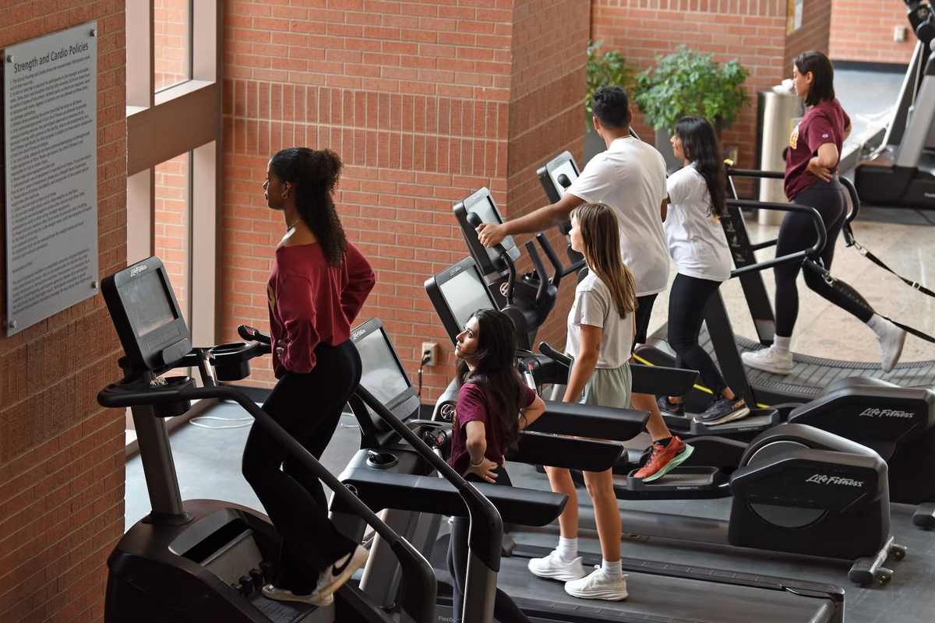
Problem Statement and Current Solutions
Problem:
The SDFC gym at ASU often becomes overcrowded, especially in the weight training rooms and basketball courts.
Students travel to the gym only to find no available equipment or space, leading to wasted time and frustration.
Since students pay facility fees, it’s important to ensure fair access and improve their overall experience.
Why We Chose This Problem:
Students' time is valuable, and improving access supports student welfare.
It directly addresses a real, everyday challenge faced by a large number of ASU students.
Current Solution and Its Issues:
Currently, students have to physically visit the gym to check space availability.
This method is inefficient, time-consuming, and leads to dissatisfaction.

Slide 4

Proposed End-to-End Solution
Solution Overview:
Use open-source crowd images from Kaggle to train the model.
Apply OpenCV for real-time people detection.
Generate heatmaps with Matplotlib or Seaborn to show crowd density across gym areas.
Display heatmaps on the app for students to check before visiting the gym.
Solution Lifecycle Steps:
Data Collection: Open-source crowd datasets.
Data Processing: Detect individuals using OpenCV.
Analysis: Map detected locations and generate density heatmaps.
Deployment: Make live crowd data accessible on the app.
Monitoring & Updates: Regularly update the model and maintain system accuracy.

Slide 5
Scope, Stakeholders, and Value of the Solution
Scope
Proof-of-concept crowd detection and visualization, with goal of enabling real-time monitoring in the future.
Aim to improve students' ability to plan gym visits efficiently.
Does not include access control, facility maintenance, or individual workout tracking.
Key Stakeholders and Beneficiaries
Students: Get real-time information to save time and plan better.
ASU & SDFC Management: Improve facility usage, enhance student satisfaction, and reduce complaints.
Value of the Solution
Saves students' time and enhances their gym experience.
Increases fair and efficient use of gym resources.
Strengthens ASU’s commitment to student welfare.

Slide 6
Success Metrics
Home
About
Detection Accuracy:
Student Usage:
01
High adoption rate: Most of the gym visitors check the crowd app before visiting.
Model accurately detects most of people present in gym images.
02
Reduction in Complaints:
User Satisfaction:
03
Decrease in student complaints related to overcrowding.
04
Positive feedback from student surveys

Slide 7
Resources, Workflow Updates, and Costs
Workflow Updates and Estimated Costs
1. People and Process:
Staff training on monitoring system
New process for 5-minute live updates
Regular system performance checks
2. Technology:
Camera installation
Backend server setup
website for students
3. Costs:
Moderate setup and maintenance costs
Includes hardware, server/cloud fees, periodic model retraining
Resources Needed
1. People:
AI developers (model building)
IT staff (maintenance)
Gym operations team (support)
2. Data:
Open-source crowd datasets (training)
Real-time camera feeds (live monitoring)
3. Systems and Computation:
Cameras installed in gym areas
GPU-enabled servers
Cloud/on-premise hosting setup

Slide 8

Monitoring and Updating the Solution
Regularly monitor system performance and crowd detection accuracy.
Track and resolve any technical issues quickly (e.g., camera or server problems).
Update the model and system over time to adapt to changing conditions.
Collect user feedback to identify areas for improvement.
Perform routine maintenance to ensure reliability and security.

Slide 9
Unintended Incentives and Consequences
Potential Issues:
Students might overcrowd certain areas once they see low-density zones.
Some students may feel uncomfortable being monitored, even if images are anonymized.
Possible over-reliance on the app, reducing flexibility in gym visits.
Mitigation Strategies:
Spread awareness about how the system protects privacy (no personal identification).
Display clear notices about monitoring and data use policies.
Encourage responsible gym usage and balanced distribution across all spaces.
Continuously collect feedback and make adjustments as needed.

Slide 10
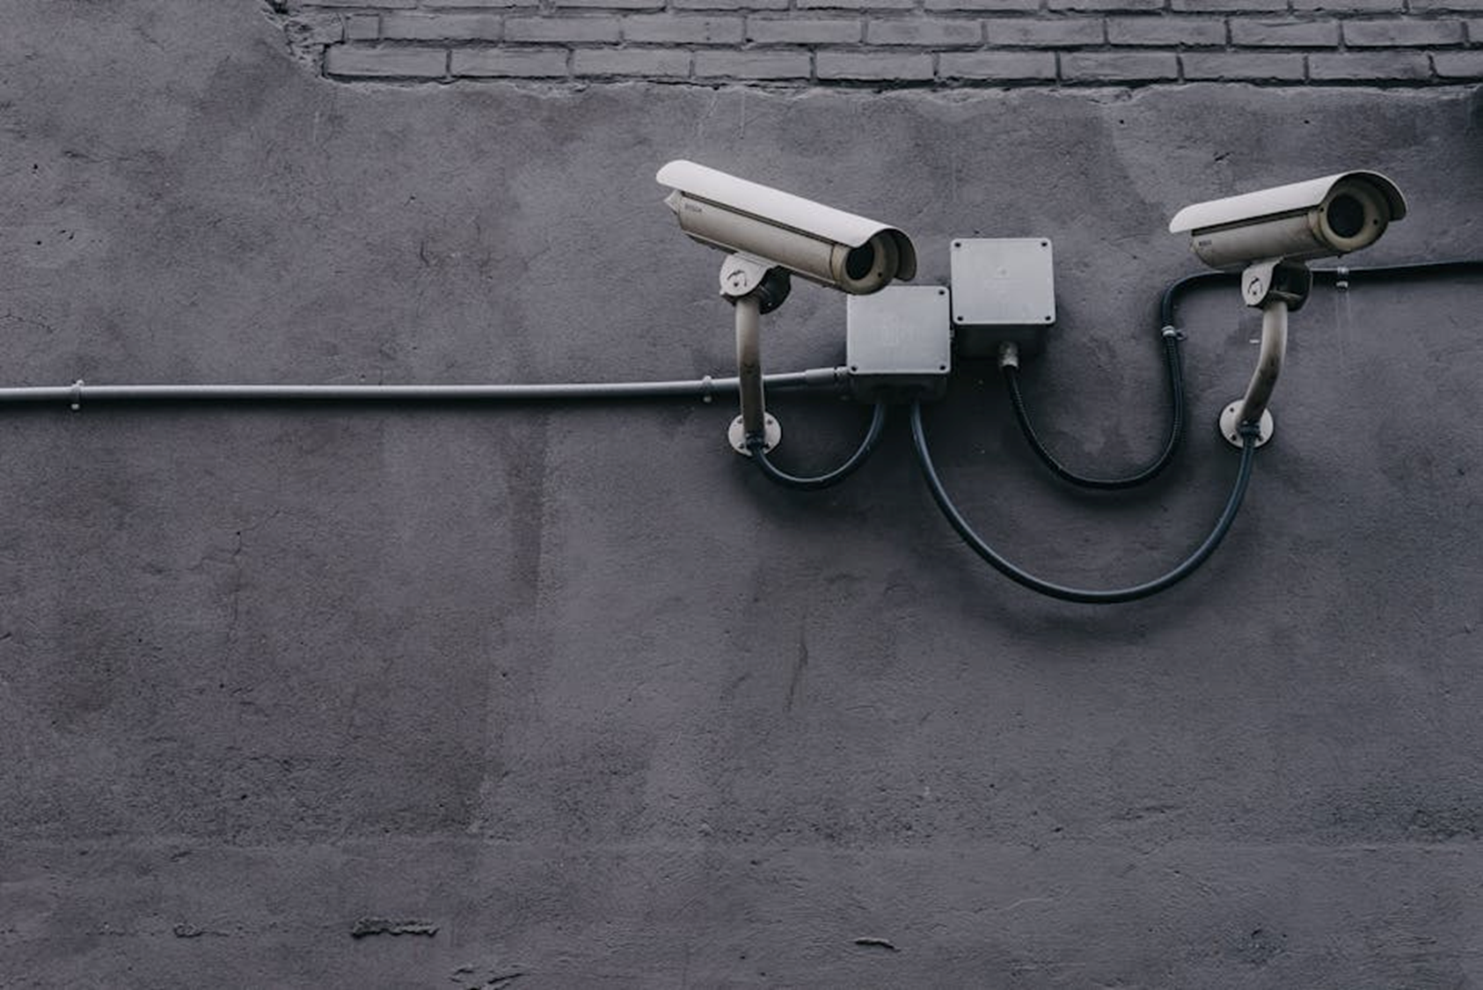
Privacy and Security Concerns
Concern
Students may feel uncomfortable being monitored while using the gym facilities.
Plan to Mitigate
Cameras will only be used for counting people, not for identifying or recording faces.
Implement strict privacy guidelines similar to GDPR standards, ensuring anonymization of all data collected.
Clear communication with users to build trust and transparency.
Similar Solutions Elsewhere
Examples:
Universities like Rutgers and UC Berkeley use apps that show gym crowd levels based on card swipes or entry sensors.
Key Differences:
Our proposal uses computer vision (CV) detection for real-time updates.
More precise as it can monitor specific zones inside the gym, not just overall entry data.

Slide 11
Technical Adjustments:
Tuning the system for lighting differences across gym areas.
Privacy Handling
Continually improving privacy protocols based on student feedback and legal standards.
Budget Adaptation:
Adjusting project scope if technology costs or infrastructure needs become higher than expected.
Scalability Potential:
Universities like Rutgers and UC Berkeley use apps that show gym crowd levels based on card swipes or entry sensors.
Key Differences:
Our proposal uses computer vision (CV) detection for real-time updates.
More precise as it can monitor specific zones inside the gym, not just overall entry data.
Lessons Learned During Project Execution

Slide 12

Scalability of the Solution
1. Can the Solution Scale?
Yes, the solution can easily be expanded to other areas within SDFC (like pools, yoga rooms, and fitness studios).
2. Expansion Opportunities:
Deploy across multiple ASU gyms and recreation centers.
Extend to other universities, public gyms, malls, libraries, and airports for crowd management.
Adapt the system for event spaces like stadiums, concerts, or conventions.
3. How to Scale:
Add more camera feeds and server capacity.
Customize heatmaps based on different facility layouts.
Train the model with new data specific to each environmen

Slide 13
Before we move on to training process…
1. Which part of your overall solution uses CV?
We use Computer Vision to detect human presence in gym frames, which is critical for generating crowd density heatmaps over time.
2. Why is CV required here?
Manually labeling people in thousands of images is time-consuming, prone to error, and not scalable. CV enables automatic detection and consistent crowd analysis, essential for real-time or large-scale monitoring.
3. What CV model did you use?
OpenCV’s HOG + SVM-based Default People Detector
Extracts gradient-based features (HOG) and classifies regions as containing a person or not using a pre-trained SVM.
Notes:
We used OpenCV’s pre-trained Haar Cascade Classifier (haarcascade_fullbody.xml) to perform full-body detection on gym images. This lightweight model is suitable for simple detection tasks and runs efficiently on standard hardware.

Slide 14
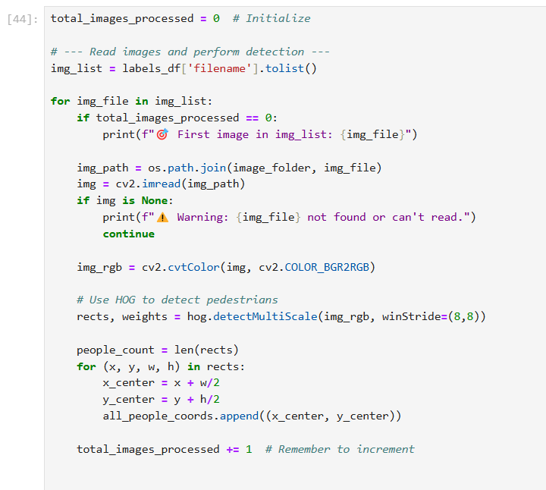
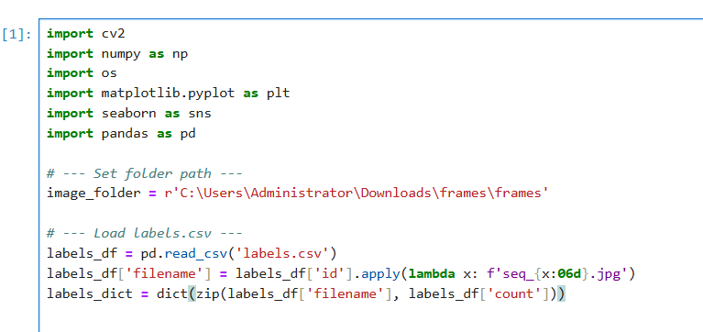
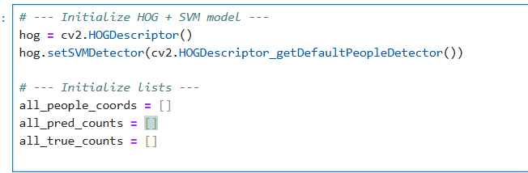
3
Model Training Details
1
Import libraries & Read the dataset
Apply HOG + SVM detector to identify pedestrians.
Record detection results:
Number of people detected
Coordinates of each detected individual
2
Model Initialization

Slide 15
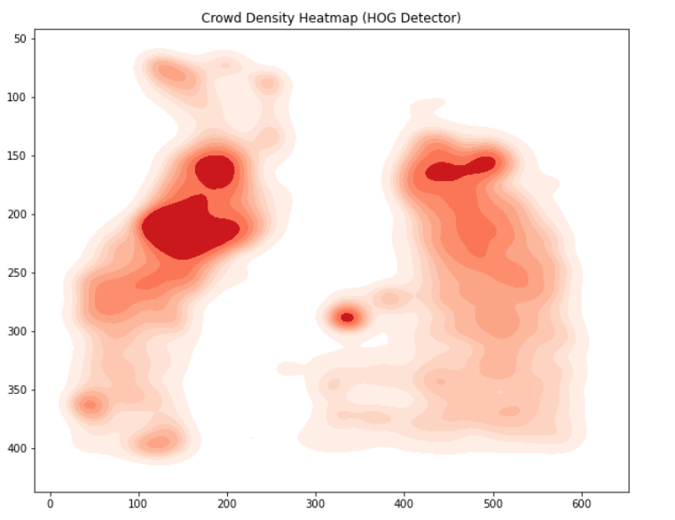
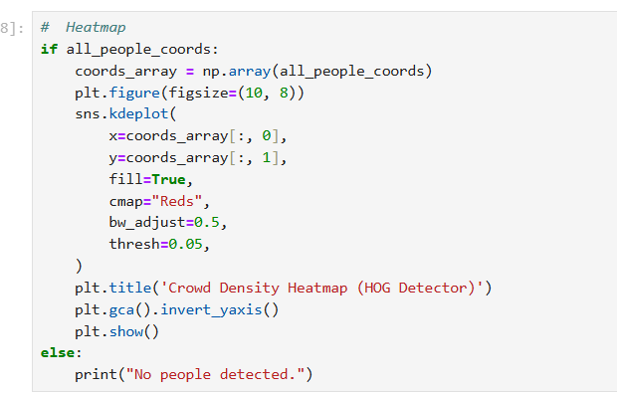
Model Training Details
Overall Crowd Density Heatmap
Plotting Heatmap
But
To better visualize the dynamic changes in crowd distribution over time, we generated a separate heatmap for each frame instead of combining all frames into a single cumulative heatmap.
Notes:
To better visualize the dynamic changes in crowd distribution over time, we generated a separate heatmap for each frame instead of combining all frames into a single cumulative heatmap. This approach allows us to capture and display the flow of people at each specific moment, enabling the creation of an animated visualization that shows how crowd density evolves across different time points

Slide 16
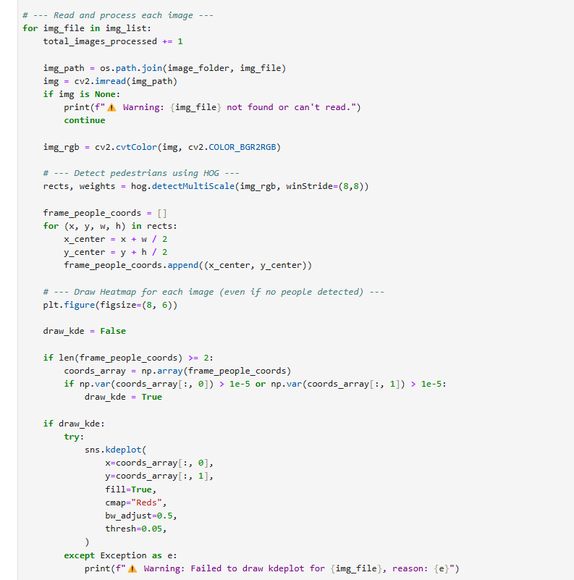
Model Training Details
Detected people for each frame individually using HOG + SVM.
Generated a separate heatmap for each frame based on detected person coordinates.
Saved each heatmap as an image for later compilation into a GIF animation.
Handled frames with no or few detections gracefully by still producing background frames.
Notes:
"After detecting people across all frames, we moved to a more dynamic visualization. Instead of combining all frames into a single heatmap, we performed per-frame detection and generated a separate heatmap for each frame, allowing us to later compile these into an animated GIF showing crowd movement over time."

Slide 17
Model Training Details
Animated Crowd Density Heatmap

Slide 18
5. How was the model evaluated?
We visually inspected the detection results by manually comparing them against the actual frames. The model performed reasonably well for moderate-density scenes, but its accuracy dropped when people were densely packed or occluded.
Overall MAE (average absolute error): 20.00 people per image
6. Pre and Post Deployment Validation
Pre-deployment, we manually validated a sample of detections against ground truth counts and calculated MAE (Mean Absolute Error) to evaluate the model’s accuracy. Post-deployment, we plan to periodically review the heatmaps and spot-check random frames for major errors.
7. Monitoring and Updating
We will regularly audit detection results. If accuracy degrades over time or if we need to handle higher-density scenes, we will consider upgrading to more advanced detectors such as YOLO.
8. Outcome-Action Pairings
We can adjust the hitThreshold parameter in hog.detectMultiScale.Setting a higher hitThreshold makes the model more conservative, detecting only strong and confident patterns of people, which helps reduce false positives and ensures safer monitoring.

Slide 19
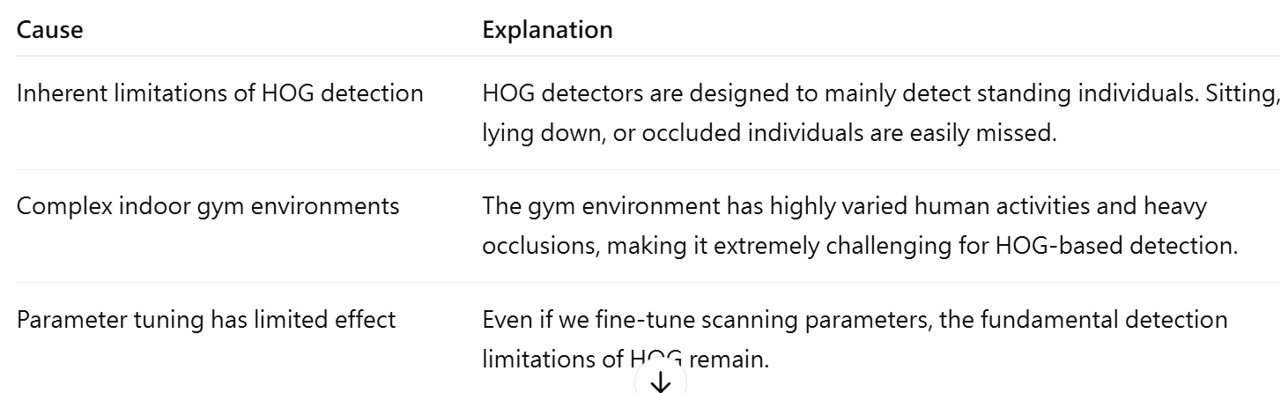

9. Bias Issues and Mitigation
10. Known Limitations
Have tried to improve the model. However, our MAE did not drop

Slide 20
Future Enhancements & Lessons Learned
We initially attempted to integrate YOLO but faced storage limitations. In the future, we plan to revisit YOLO integration.
We also learned that maintaining high image quality is critical for improving detection performance.

Slide 21
Conclusion
Solution: Built a crowd detection and visualization system using OpenCV and heatmaps to monitor gym occupancy.
Findings: Traditional HOG-based detection works for moderate crowds but struggles under occlusion and complex movements. Image quality critically impacts detection accuracy.
Limitations: Poor performance in crowded, low-light, or non-standard pose scenarios. Storage limitations restricted advanced model integration.
Possible Extensions: Develop a mobile app to provide real-time crowd level updates for students.
Future Work: Integrate lightweight YOLO models and fine-tune on gym-specific datasets to enhance detection robustness.

Slide 22
Reference
OpenCV GitHub Repository
https://github.com/opencv/opencv/blob/4.x/samples/python/peopledetect.py
2. Histogram of Oriented Gradients Explained
https://learnopencv.com/histogram-of-oriented-gradients/
3. University of California, Berkeley – RecWell
https://recwell.berkeley.edu/recreation-wellbeing-program-and-service-updates/
4. Devpost Project - RU Gyms Crowd Meter
https://devpost.com/software/ru-gyms-crowd-meter
5. Kaggle resorce-- Crowd Counting
https://www.kaggle.com/datasets/fmena14/crowd-counting/data

Slide 23
Thank You For
Attention
515
By : Team008

Slide 24

Task Ownership and Contribution Summary - Team 008
Every team member contributed to creating the PowerPoint.
Rasika:
Defined the problem, stakeholders, and success metrics. Loaded the Kaggle dataset, and converted images to RGB. Created slides for the problem statement, dataset handling. Presenting Introduction.
Maria:
Outlined the solution lifecycle, scope, and workflow. Responsible for end to end solution. Made slides for solution flow. Presenting the end to end solution.
Yu Chin:
Set up the HOG + SVM people detector. Generated and styled heatmaps from detection results. Created slides for heatmaps, and outcome-action mapping. Presenting model training.
Balbir:
Handled cost-benefit analysis, risk, and privacy topics. Counted detected people, matched them with true labels, and calculated MAE for evaluation. Prepared slides for evaluation results, MAE, and risks. Presenting conclusion.
Harsh:
Summarized findings, limitations, and future scope, and compiled references. Inspected sample heatmaps manually and verified outputs. Prepared slides for conclusion.

